Slide 1

Multiagent systems
E-Portfolio

Slide 2
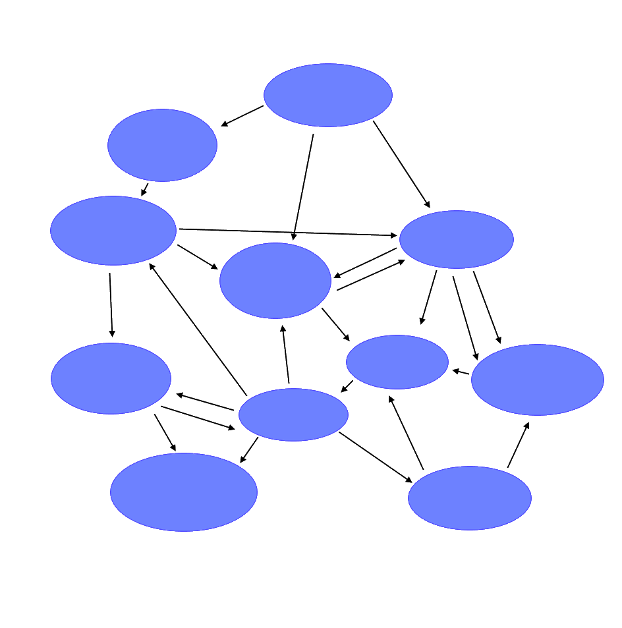


Content
Multiagent Systems
NetLogo
Examples
Notes:
21.04.2021

Slide 3
Multiagent Systems
Consisting of multiple units
No central controlling unit
Progress is made by interaction between the Agents
Can be set up in different Environments
  Virtual Environment
  Discrete Environment
  Continuous Environment
  Real World
Notes:
Virtual: Computer, Discrete: Chess Board, Continiuous: Endless moves (Ant Stock)

Slide 4
Approach
Multiagent System
Monolithic System
No “almighty” core
Decentralized decision making
Independent units
Fully modular
In comparison simple logic for each agent
More resource usage because of basic needs of agents
Central controlling core
Central decisions
Controlled units
Partly modular
Very complex core logic
Efficient resource usage

Slide 5
Agent types
Every Agent is self directed
Different types of agents in a System
  Passive agents
  Active Agents
  Cognitive Agents
Notes:
Passive: No own targets (Food Object), Active: Follows own targets (Ant), Cognitive: Interface

Slide 6
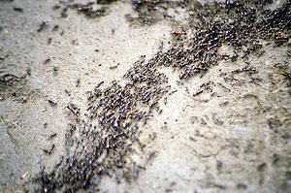
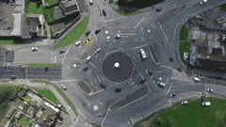
Examples
Ant Colony
Stock Market
Traffic
Software
Notes:
Ant Colony -> every worker supports the hive, but they are all self controlled. Ants communicate via smells and pheromones
I the Stock market every “player” follows his own targets (maximalise the own capital)

Slide 7
NetLogo

Slide 8
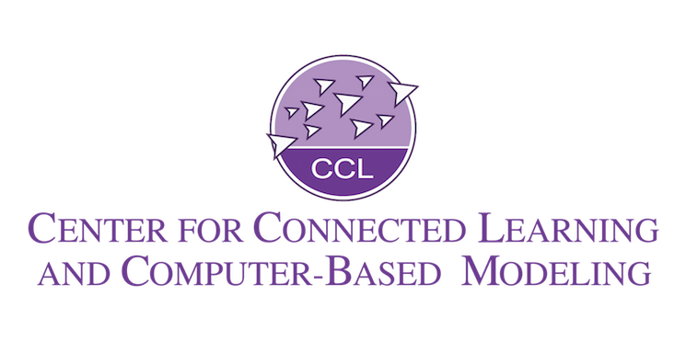
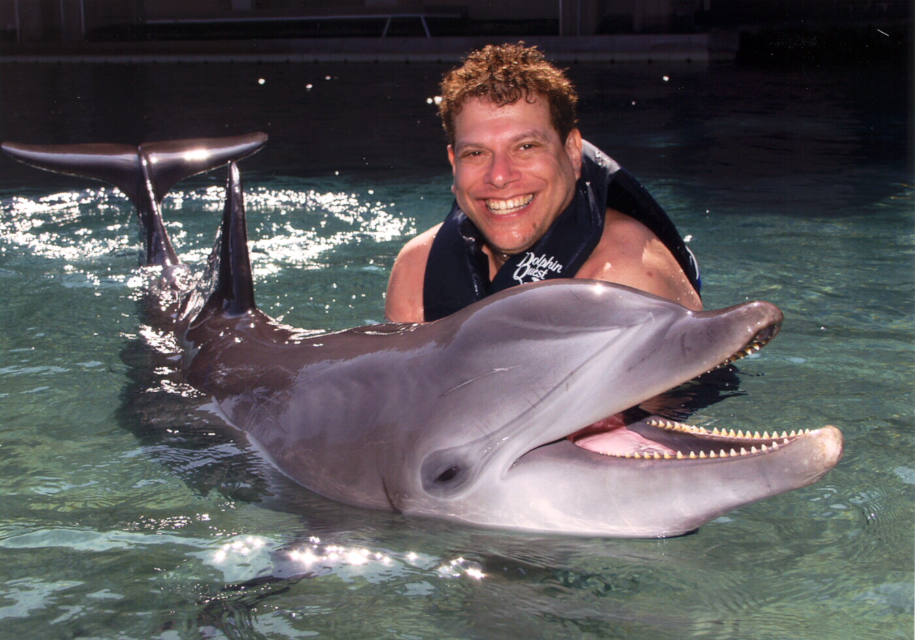
Overview
Multi-Agent modeling environment
Open Source
Developed since 1999 at CCL
Authored by Uri Wilensky
Available as App or via Web Interface
Worldwide use in Education and Science

Slide 9
The World
The “World” consists of square shaped Agents: Patches
Variable size of the world
The Patches have coordinates
  0, 0 is always in the middle
The world is “wrapped”
  everything that goes out on One Side, comes in on the other
Mobile Agents are called Turtles
Agents can move in any direction (if programmed)
They can have any form or model
  NetLogo brings many different models with it
Notes:
Dialect of the Language LOGO

Slide 10
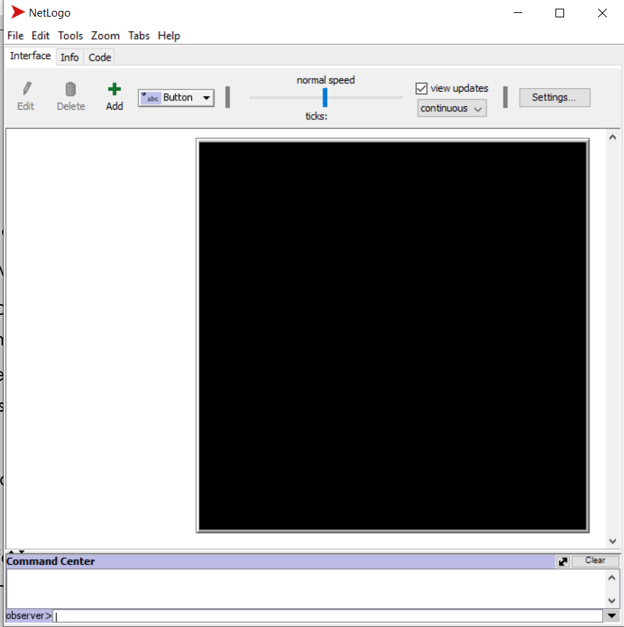
Programming
Commands are given via the Observer
For more complex commands use the “Code” Tab
Commands are Addressed to the Agents
  Patches
  Turtles
  Links
  Self defined groups
Notes:
For example all

Slide 11
Basic Commands
Command | Explanation
create-turtles number create-<breeds> number | Creates the defined number of turtles, they will all look in random directions
forward number backward number | Let the selected turtles make number steps for- or backwards
left number right number | Let the addressed Turtle turn number degrees left or right
pen-down pen-erase pen-up | Defines if the Turtles shall draw a line (in their color) erase other lines or shall do neither
die | The turtle will be deleted

Slide 12
Programming
Command | Explanation
ask agent [commands] | Selects all agents (turtles, patches, etc.) and let them execute the commands in the brackets
breed [plural singular] | Defines groups of turtles
to functionName … end | Declares a funktion
Let x 20 Set x x+1 | Declares a variable Increases a variable

Slide 13
Help and Tutorials
User guide/tutorial, provided by the developer
  https://ccl.northwestern.edu/netlogo/docs/tutorial1.html
Dictionary with full command list
  https://ccl.northwestern.edu/netlogo/docs/dictionary.html#

Slide 14
Examples

Slide 15
Task
Go to http://www.netlogoweb.org/launch
Visit the GitHub repository, linked in the “eportfolio-announcement” channel in discord
Download the file “PredatorPreyTask.nlogo“
Open the file with NetLogo Web
Try to write an avoidance algorithm in the function “preystep” (line 58)
  10 min
You can use the command collection on the handout or use the net logo Dictionary
  https://ccl.northwestern.edu/netlogo/docs/dictionary.html#

Slide 16
Sources
http://www.bsslab.de/assets/mas2k.script.pdf - Universität Koblenz, (PD) Stefan Bosse, 2018-07-12
http://ccl.northwestern.edu/Uri.shtml-lastcall21.04.21
http://ccl.northwestern.edu/netlogo/faq.html
https://ccl.northwestern.edu/netlogo/docs/tutorial1.html
https://ccl.northwestern.edu/netlogo/docs/dictionary.html
https://ccl.northwestern.edu/netlogo/2.0/docs/programming.html
  Wilensky, U. 1999. NetLogo. http://ccl.northwestern.edu/netlogo/. Center for Connected Learning and Computer-Based Modeling, Northwestern University. Evanston, IL.

Slide 17
Image sources
https://thumbs.gfycat.com/YoungSilverGoa-max-1mb.gif
https://upload.wikimedia.org/wikipedia/commons/thumb/3/34/Safari_ants.jpg/300px-Safari_ants.jpg
https://ccl.northwestern.edu/Front%20page%20images/cclLogo.png
http://ccl.northwestern.edu/Staff%20Pics/uri+dolphin3.jpg
https://upload.wikimedia.org/wikipedia/commons/2/2c/Remi_turtlegrafik.png

